Slide 1
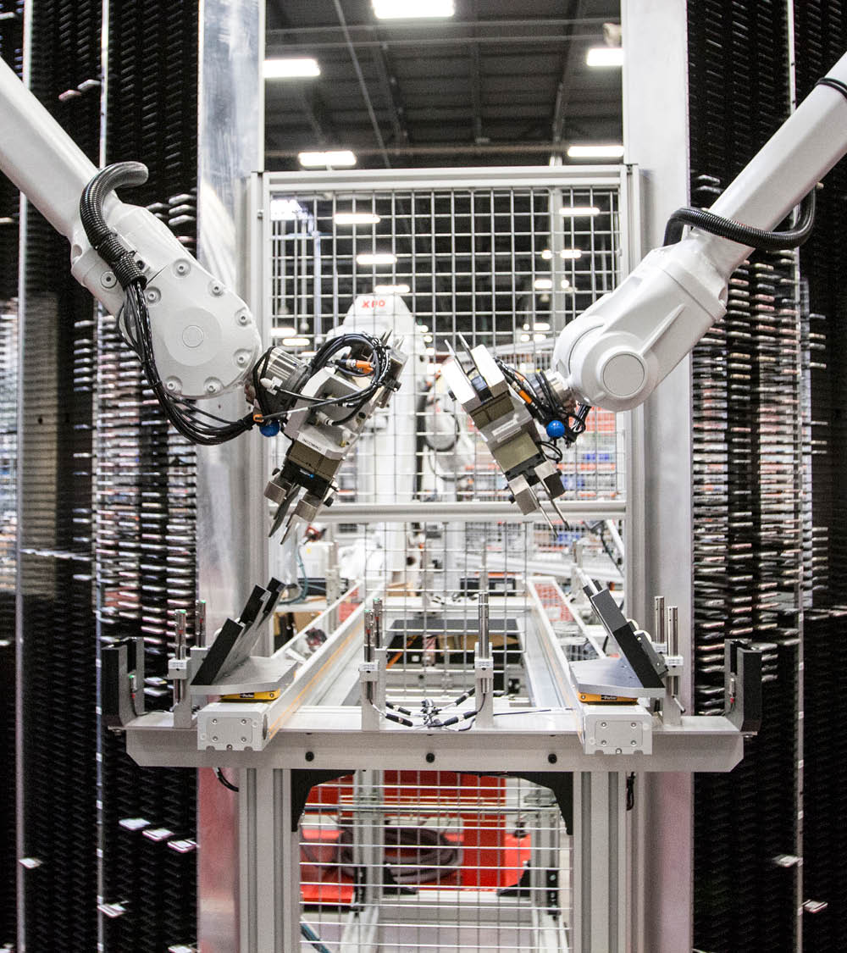
SRE Site Reliability Engineering
Boston Code Camp 34
2023-04-29
@ababiec

Slide 2
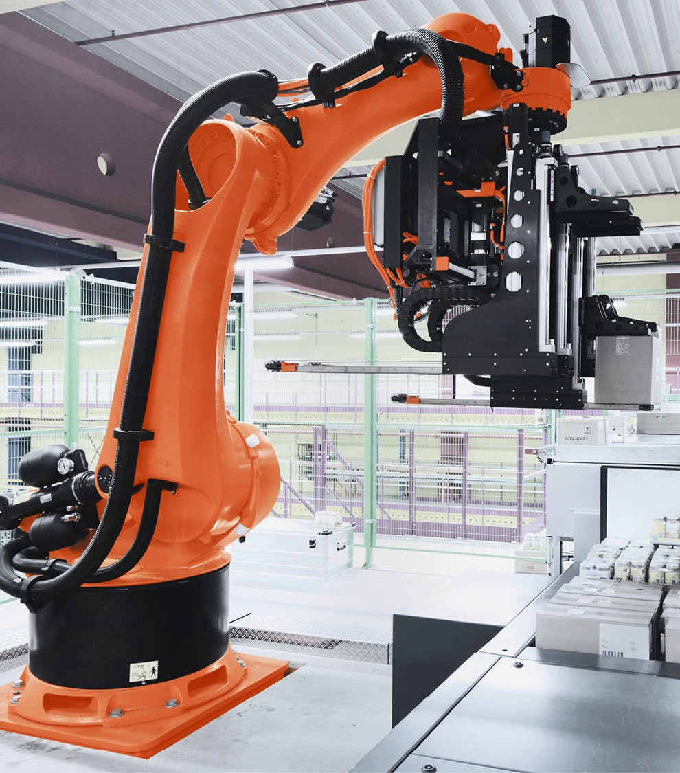
What is SRE?
Set of principles and practices that incorporates aspects of software engineering to automate oversight and management of software systems.
The goal is to create and maintain software applications that are scalable and highly reliable.
SRE team is responsible for the availability, latency, performance, efficiency, change management, monitoring, emergency response, and capacity planning of the application/site/system.

Slide 3
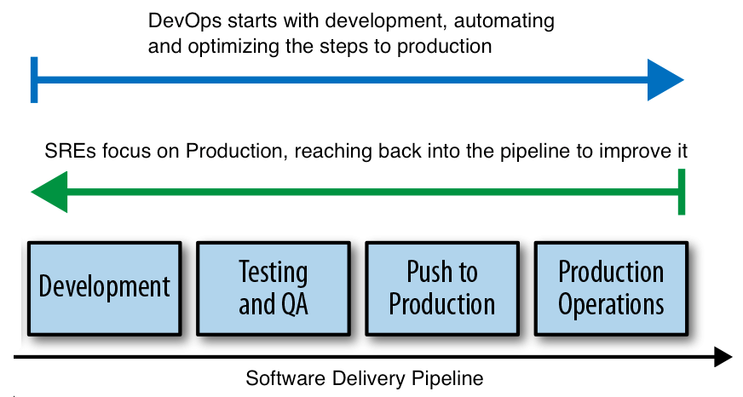
SRE vs DevOps

Slide 4
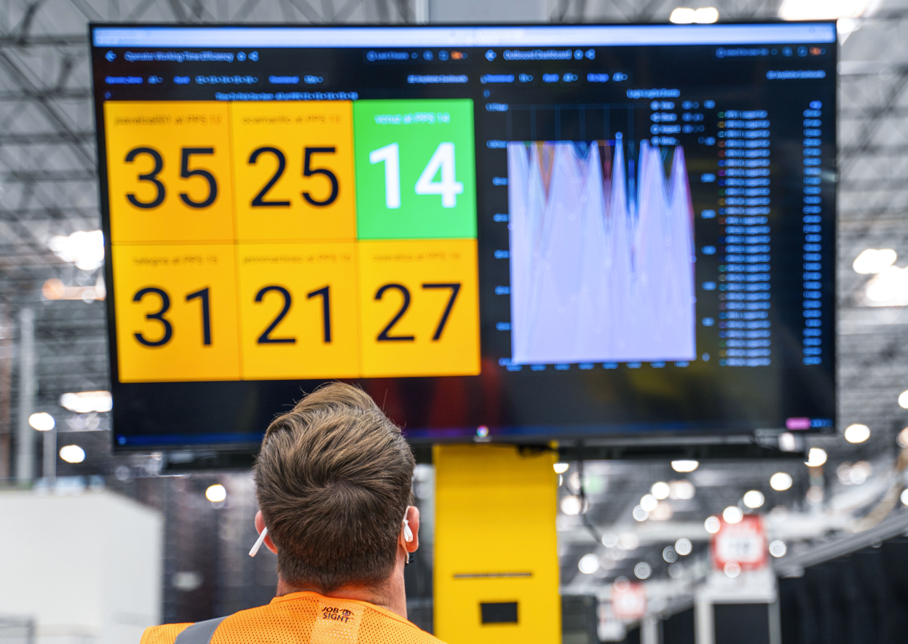
SRE Principles
Focus on Engineering: Sysadmins not scalable -> Automation
Provide guidance on designing resilient systems
Max Change Velocity without sacrificing Stability
Monitoring & Alerting
Emergency Response: MTBF, MTTD, MTTR
Change Management: Progressive rollouts & rollbacks
Demand Forecasting and Capacity Planning + Provisioning
Continuous Improvement (Measuring & Tracking)

Slide 5
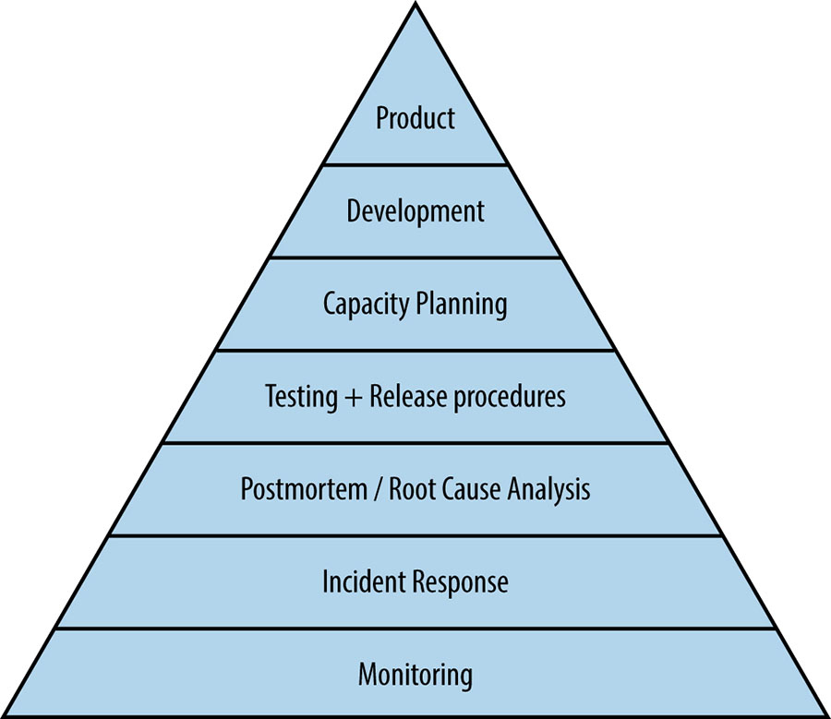
Organizational and Platform Maturity
Change in Mindset
Proactive vs. Reactive
Manual -> Automated -> Autonomous
Learn from Failure: Postmortem Culture
Incident Management: ad hoc -> process
Service Reliability Hierarchy

Slide 6
Our SRE journey
Mission-critical warehouse efficiency system
North America & EU
24-7
100+ microservices/workloads
100's of pods, 50 nodes
Very data-intensive
GCP, GKE, Kafka, Elastic, SQL, BigQuery
Result: fire-fighting, unhappy end-users, tired team
Dev Team Size: 20
Competent DevOps
Spearheaded SRE within the company
Adopted SRE in our team out of necessity
SRE responsibilities assigned weekly to developers
Work on SRE improvements
Used EU developers for overnight coverage
Biggest Improvement: Communication (Site Banner)

Slide 7
Practices
End-to-End Monitoring, Dashboards
Uptime/High Availability – Identify Points of Failure
Indicators/Signals
Alerts / Tickets / Logging
Observability of distributed systems: Visualization / Interactions / Connectivity
Effective Troubleshooting – guidance and runbooks vs. winging It
Analyzing long-term trends, Comparing over time, Conducting ad hoc retrospective analysis
Eliminate “toil” (operational work tied to running a production service that tends to be manual, repetitive, does not scale)
Avoid Blame, Keep it Constructive. Share learnings, Collaborate

Slide 8
Define SLO’s & SLI’s
 |  | SLO | SLI
API | Availability | count of api http_requests which do not have a 5XX status code divided by count of all api http_requests | 97% success
API | Latency | count of api http_requests with duration <= 0.4s divided by count of all api http_requests | 90% of requests < 400 ms
API | Freshness | count of all data_requests for api with freshness <= 1m divided by count of all data_requests | 90% of reads use data written within the previous 1 minute
ETL | Completeness | count of all pipeline runs that processed 100% of the records divided by count of all pipeline runs | 99% of pipeline runs cover 100% of the data
ETL | Correctness | count of all data_requests which were correct divided by count of all data_requests | 99.9999% of data ingestion records result in the correct output
Service Level Agreement
Service Level Objective
Service Level Indicator
Error Budgets & Error Budget Policy

Slide 9
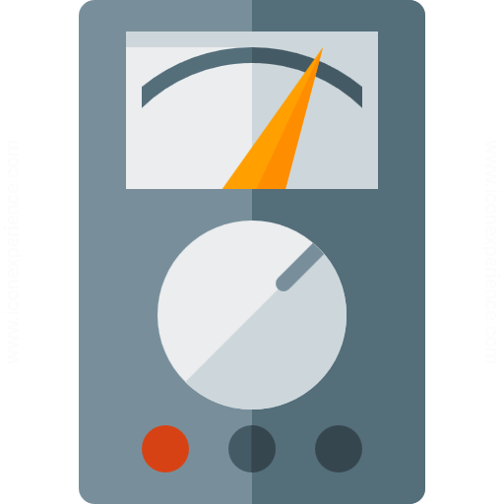
Golden Signals
Latency: time it takes to service a request (track successful requests and failures/errors.) Slow feedback is a symptom of degraded performance somewhere.
Traffic: measure of how much demand is being placed on your system (requests/sec, transactions/sec, network I/O, concurrent sessions)
Errors: rate of requests that fail
Saturation: How close to 100% utilization (memory, I/O, disk space.) Most services degrade in performance as they approach saturation (80%.)

Slide 10
What can go wrong?
Failures/downtime
Disk/Storage
CPU
Memory
Network
Security
Data
Hardware, Power, Cloud
Dependencies
Firewall rules
Pod/container in a restart loop
Misconfiguration
Certs expiring
Missing/Invalid data/file formats
Race conditions / deadlocks
DOS attacks
Resource contention
Unexpected (ex: virus scanners)

Slide 11
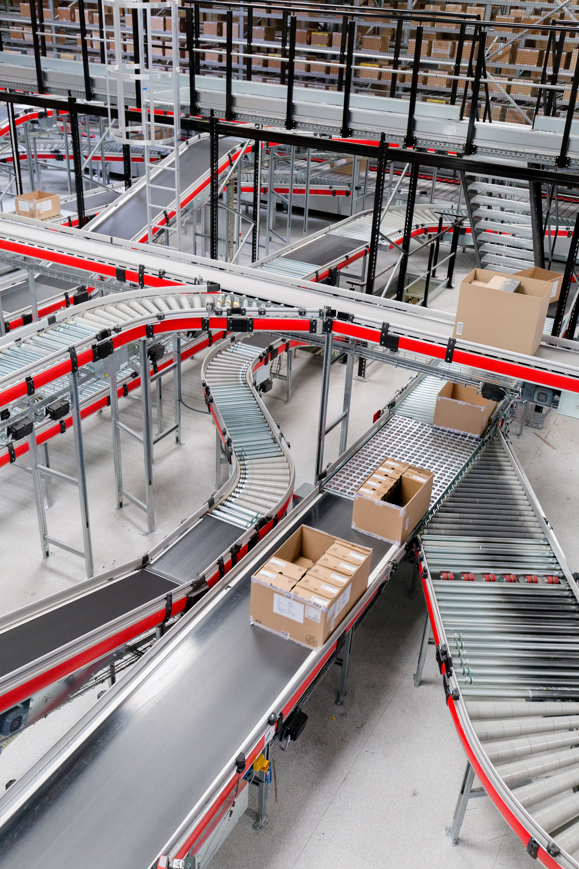
Post-mortems/Root Cause Analysis (RCA)
Incident Report:
Actual vs Expected Behavior
Timeline
Impact
Findings
Mitigations (short-term and long-term)
Root cause (5 whys)
Follow-up actions/steps

Slide 12
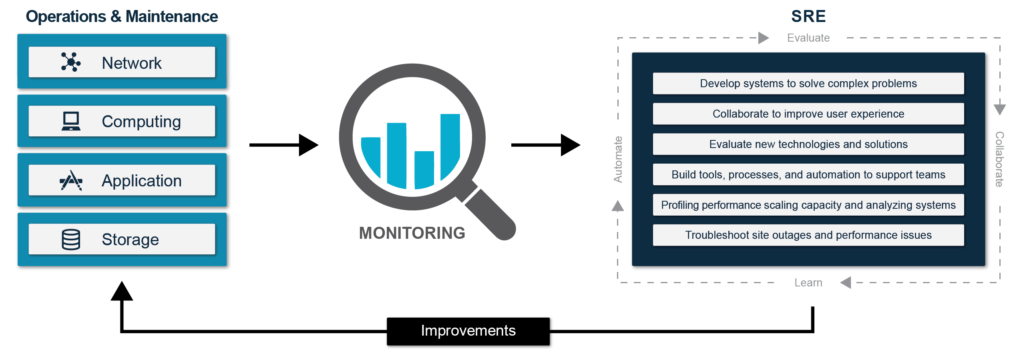
SRE lifecycle

Slide 13
Monitoring
Dashboards
Metrics
Logs
Uptime checks
Alerts - a human needs to take action immediately
Tickets - human needs to take action, not immediate
Logging - recorded for diagnostic or forensic purposes
Alerts
Criteria
Should be based on symptoms
Should be actionable
Who & How to be notified
Choosing an Appropriate Resolution for Measurements
Aggregation - averages, distributions, percentiles

Slide 14
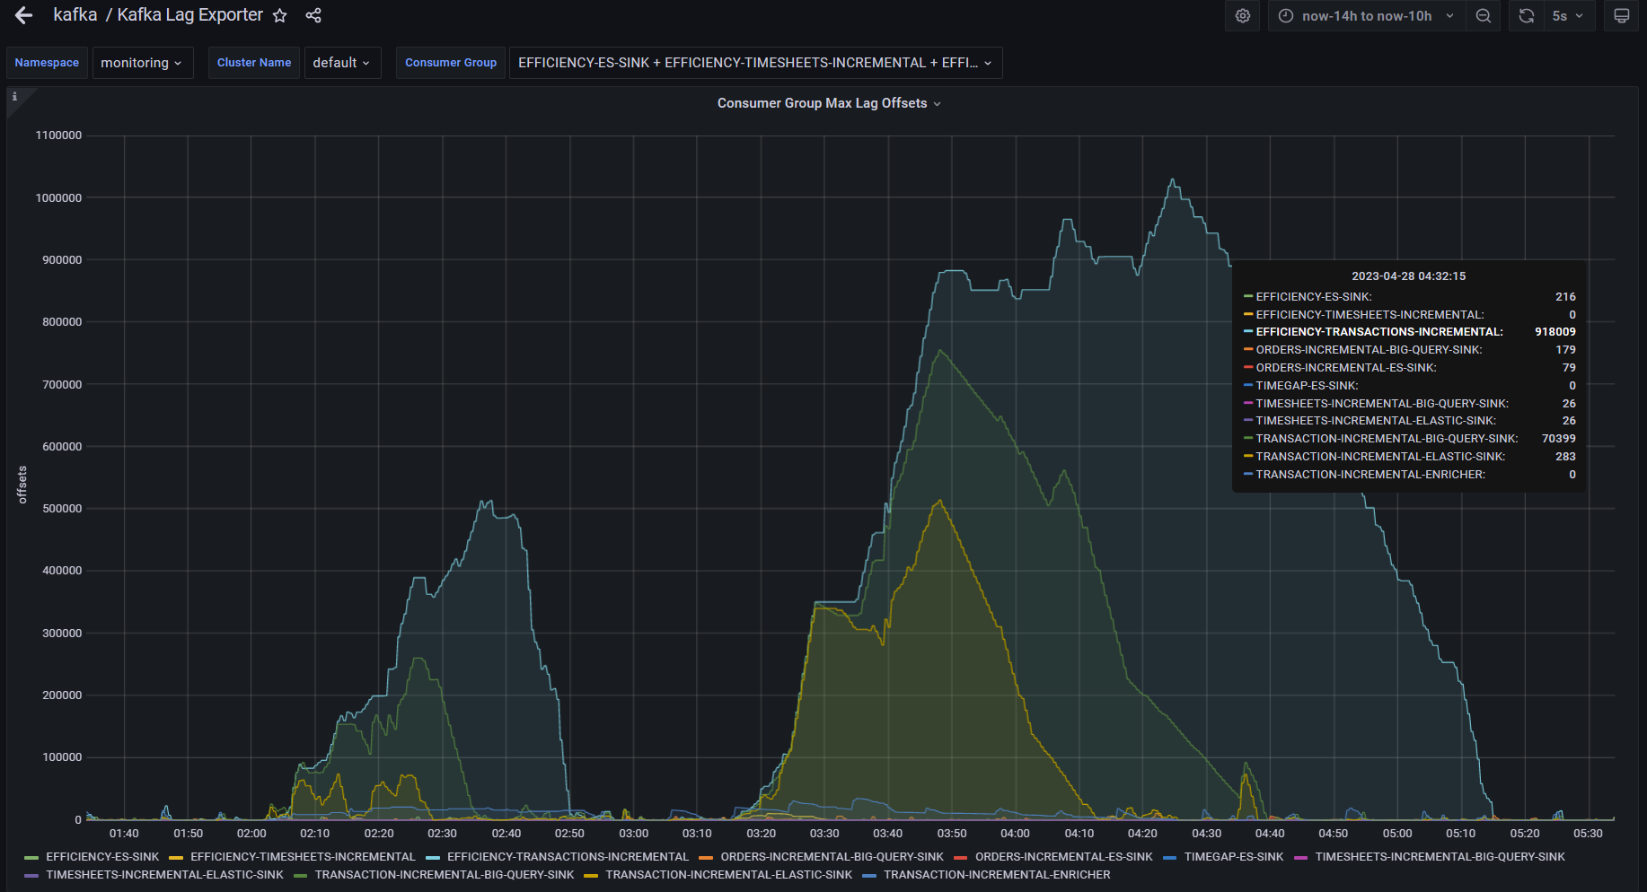
Prometheus & Grafana

Slide 15
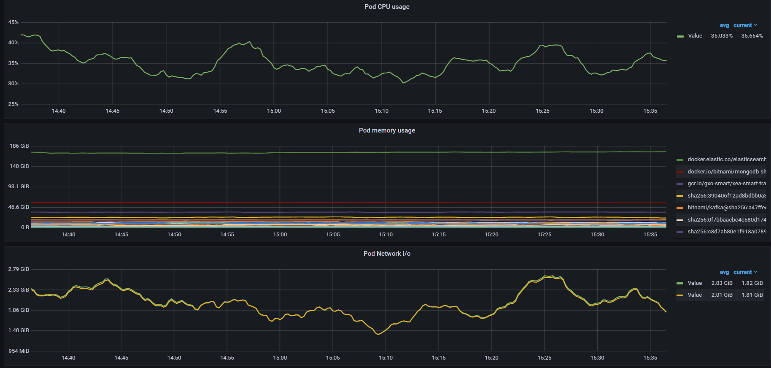

Slide 16
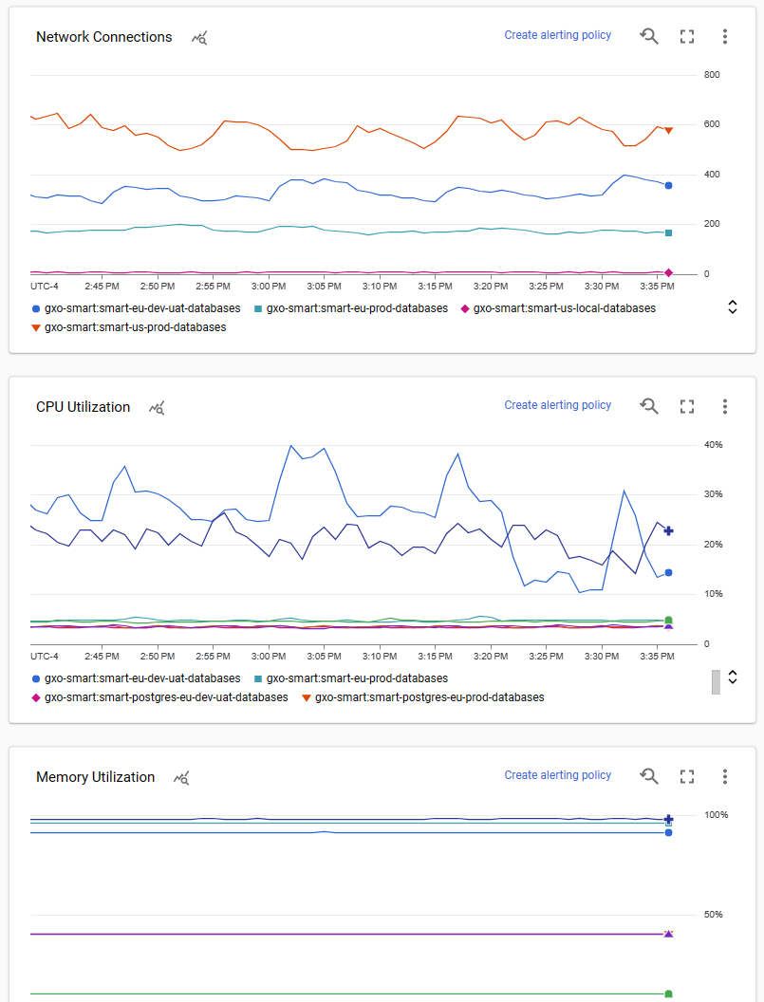
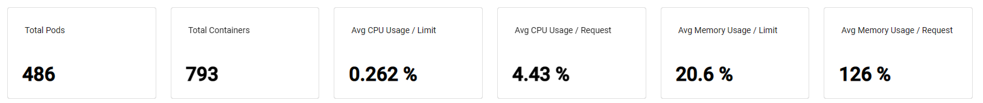
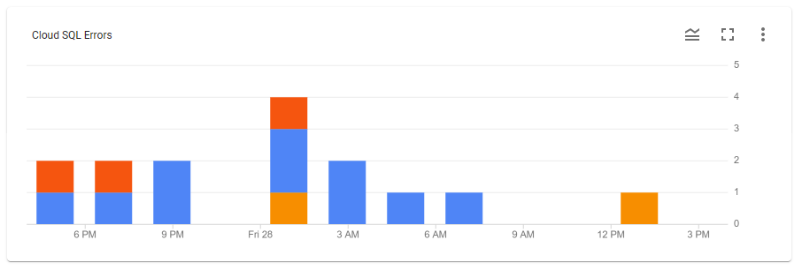
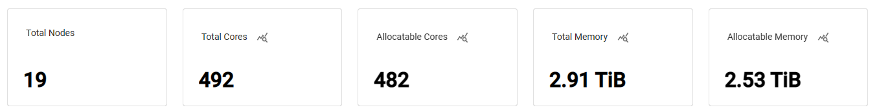
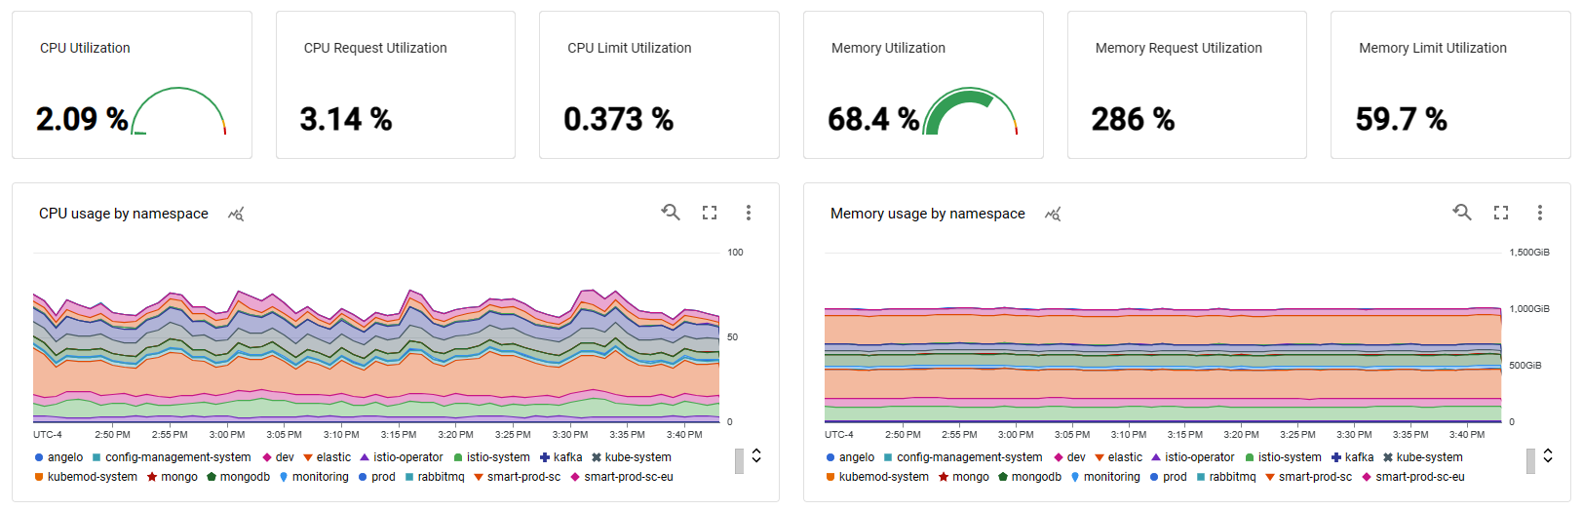
GCP native monitoring

Slide 17
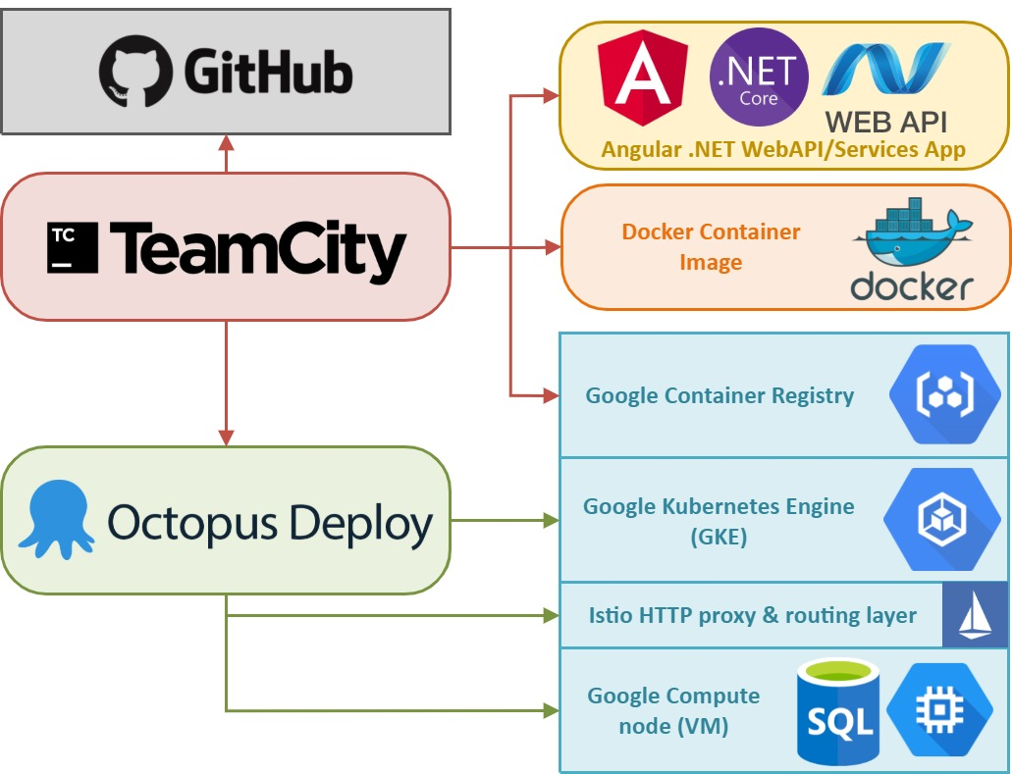
CI/CD pipeline

